Slide 1

Introduction To Spring Boot

Slide 2
What Is Spring boot:
Spring Boot is a Framework from “The Spring Team” to ease the bootstrapping and development of new Spring Applications. It provides defaults for code and annotation configuration to quick start new Spring projects within no time. It follows “Opinionated Defaults Configuration” Approach to avoid lot of boilerplate code and configuration to improve Development, Unit Test and Integration Test Process.
Features:
Create stand-alone Spring applications.
Embed Tomcat, Jetty or Undertow directly (no need to deploy WAR files)
Provide opinionated 'starter' dependencies to simplify your build configuration
Automatically configure Spring and 3rd party libraries whenever possible
It also minimizes the writing multiple boilerplate codes(Repeated codes).

Slide 3
Why Spring boot:
Spring Boot gives an easier, quicker path to set up, configure, and run apps. It eliminates the heavy lifting of configuration that is required for setting up most Spring-based apps. Developers can jump right in and use Spring Boot without ever having to learn the underlying Spring framework.

Slide 4
Advantages of Spring boot:
It is very easy to develop Spring Based applications with Java or Groovy.
It reduces lots of development time and increases productivity.
It avoids writing lots of boilerplate Code, Annotations and XML Configuration.
It is very easy to integrate Spring Boot Application with its Spring Ecosystem like Spring JDBC, Spring ORM, Spring Data, Spring Security etc.
It follows “Opinionated Defaults Configuration” Approach to reduce Developer effort
It provides Embedded HTTP servers like Tomcat, Jetty etc. to develop and test our web applications very easily.

Slide 5
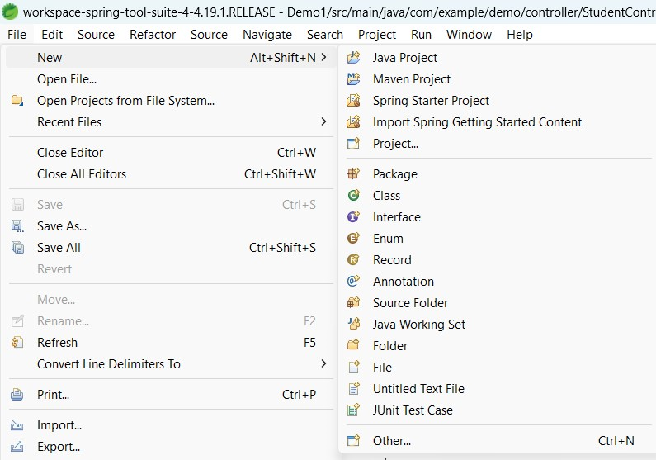
How to Create a Simple Project on spring boot?
Step 1: Go to StringToolSuite4 Application.
Step 2: Click on file on the top left corner and select New option and select Spring starter Project.

Slide 6
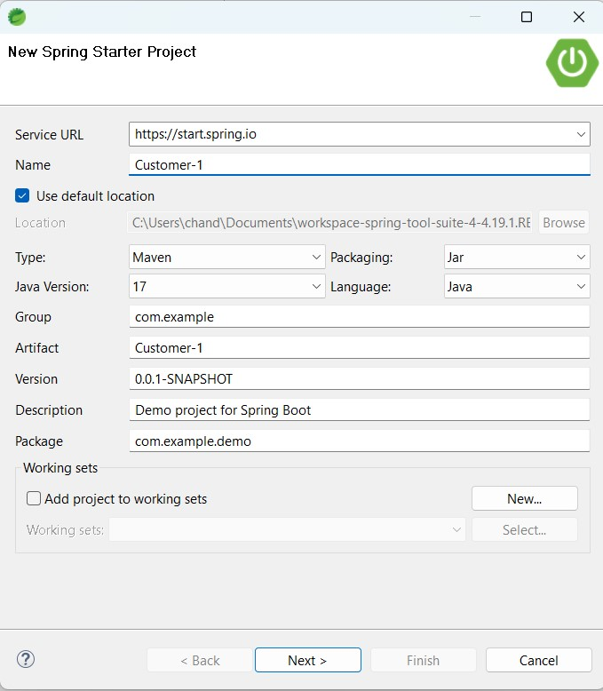
Step 3: Enter Project Name , Type – Maven, packaging – jar, Java Version – 17, Language – Java and Package name and click on next.

Slide 7
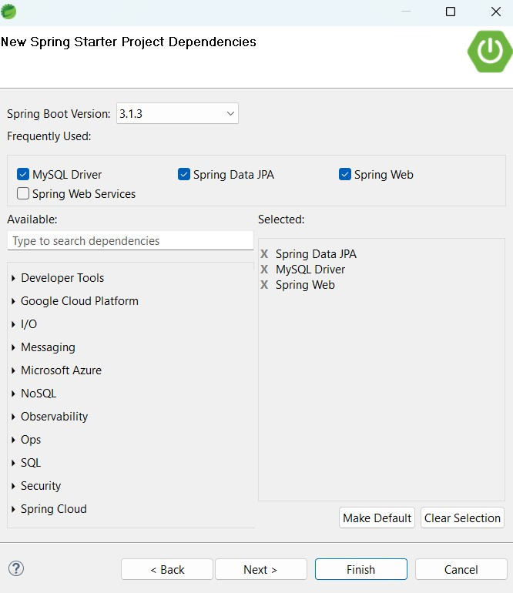
Step 4: Select the Dependencies what you have like Spring Data JPA, MySQL Driver
and Spring Web and click on Finish.

Slide 8
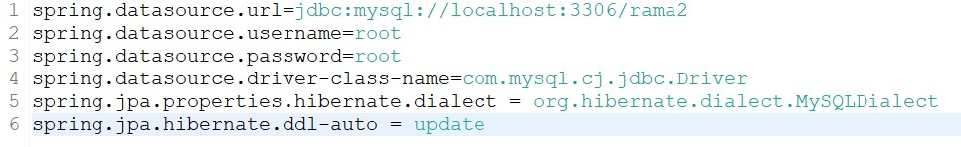
Step 5: There are 3 Annotations in the @SpringBootApplication like
@EnableAutoConfiguration, @SpringConfiguration and @ComponentScan
Step 6: Create Packages like controller, modal, Repository and service with the main Package like
→ com.example.demo.Controller
→ com.example.demo.Modal
→ com.example.demo.Repository
→ com.example.demo.Service
And packages are used to separate the logic.
Step 7: we need to write the url, username and password of database sources in the application.Properties like

Slide 9
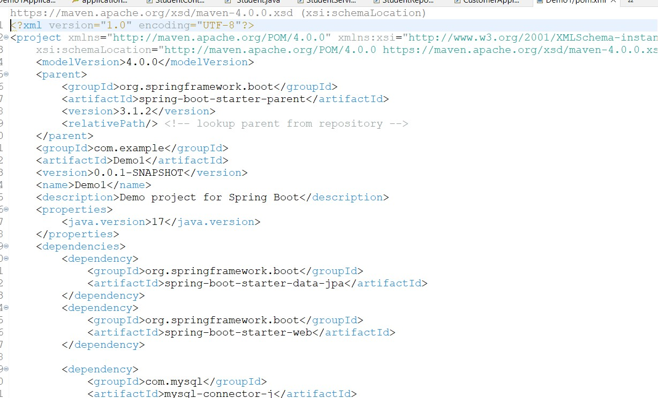
Step 8: pom.xml (project object modal) It is a fundamental unit of work in Maven. pom is a XML file that contains information about the project and configuration details used by Maven to build the project.

Slide 10
Step 9: Write the code for the new project with the help of packages.
Step 10: com.example.demo
→ It is the Main Package in the application file.
Step 11: Create new Package like com.example.demo.User
→ It is the Modal Class or Entity Class or pojo class.
→ @Entity means it is the Entity Annotation to create table of values for the fields.
→ @Id means it is using for Primary key of an Entity. And it is not null and unique Values.
→ @GeneratedValue means it is for Auto increment the Id.
→ select the get and set the values for all fields.
Step 12: Create new Package like com.example.demo.UserController
→ It is the Controller class
→ The controller classes in Spring are annotated either by the @Controller or the @RestController annotation.
→ Controller class contains public methods called Action methods. Controller and its action method handles incoming browser requests, retrieves necessary model data and returns appropriate responses.

Slide 11
Step 13: Create a new Package like com.example.demo.UserRepository
→ It is an Interface Class
→ It extends JpaRepository and it is having the inbuilt Methods. By using this it will internally performs the methods.
→ it holds some custom methods like findById(), save(), findAll() and more..
Step 14: Create a new Package like com.example.demo.UserService
→ It is a Service class
→ it contains the @Service Annotation and allows developers to add business Functionalities.
→ Here we can do some crud operations.

Slide 12
Annotations in Spring boot
@Autowired → It is used for loose coupling or automatic dependency injection.
@PostMapping -> we can post the data into the MySQL by using http request.
The @PostMapping is a specialized version of @RequestMapping annotation that acts as a shortcut for @RequestMapping(method = Request Method. POST) . The @PostMapping annotated methods handle the HTTP POST requests matched with the given URI expression.
@GetMapping -> we can simply get the all data and a specific id we can used to get the data.
With the help of @GetMapping annotation we can easily define endpoints of RESTful API and handle various HTTP requests. @GetMapping annotation is used for mapping HTTP GET requests onto specific handler methods. It is composed annotation that acts as a shortcut for @RequestMapping(method=RequestMethod. GET).

Slide 13
@PutMapping -> we can simply update the overall data.
@PutMapping: This spring boot annotation is used for handling the incoming put request from the client side. Note: First we need to establish the spring application in our project. Spring Initializer is a web-based tool using which we can easily generate the structure of the Spring Boot project.
@DeleteMapping ->we can delete the data by using any id.
The @DeleteMapping annotation is a Spring annotation that is used to map HTTP DELETE requests onto specific handler methods. It is a shortcut for @RequestMapping annotation with method = RequestMethod. DELETE attribute.

Slide 14
Thank you

